Slide 1
New WRDTP and the Virtual Interdisciplinary Research Environment (VIRE)
This document will talk you through how to access the new WRDTP website and the VIRE (the Virtual Interdisciplinary Research Environment).
The VIRE is a new development, which will gather and curate a variety of resources to help researchers support their work.
To access the VIRE; students will need a username and password which will be issued at an institutional level.
Students will not receive their own individual login credentials; each university should issue the usernames you can find on the next page to their students.
The new website site can be found at wrdtp.ac.uk

Slide 2
Institutional Usernames and Passwords
You can find the Usernames and Passwords for each University listed below; these will allow students into the locked VIRE area of the site. The way that the system is designed is that e.g. all students who are studying at Leeds, use the Leeds username and password.
Please note that the usernames and passwords are case-sensitive and will be changed annually on 1st September. Please contact the WRDTP Office to find out the new password.
University | Username | Password
University of Bradford | bradford@wrdtp.ac.uk | VIREaccess2018
University of Hull | hull@wrdtp.ac.uk | VIREaccess2018
University of Leeds | leeds@wrdtp.ac.uk | VIREaccess2018
Manchester Metropolitan University | mmu@wrdtp.ac.uk | VIREaccess2018
University of Sheffield | sheffield@wrdtp.ac.uk | VIREaccess2018
Sheffield Hallam University | hallam@wrdtp.ac.uk | VIREaccess2018
University of York | york@wrdtp.ac.uk | VIREaccess2018
The following pages contain a user guide to show students how to login to the system and access the VIRE Content. For a video guide to see how to login; please view this link here.

Slide 3
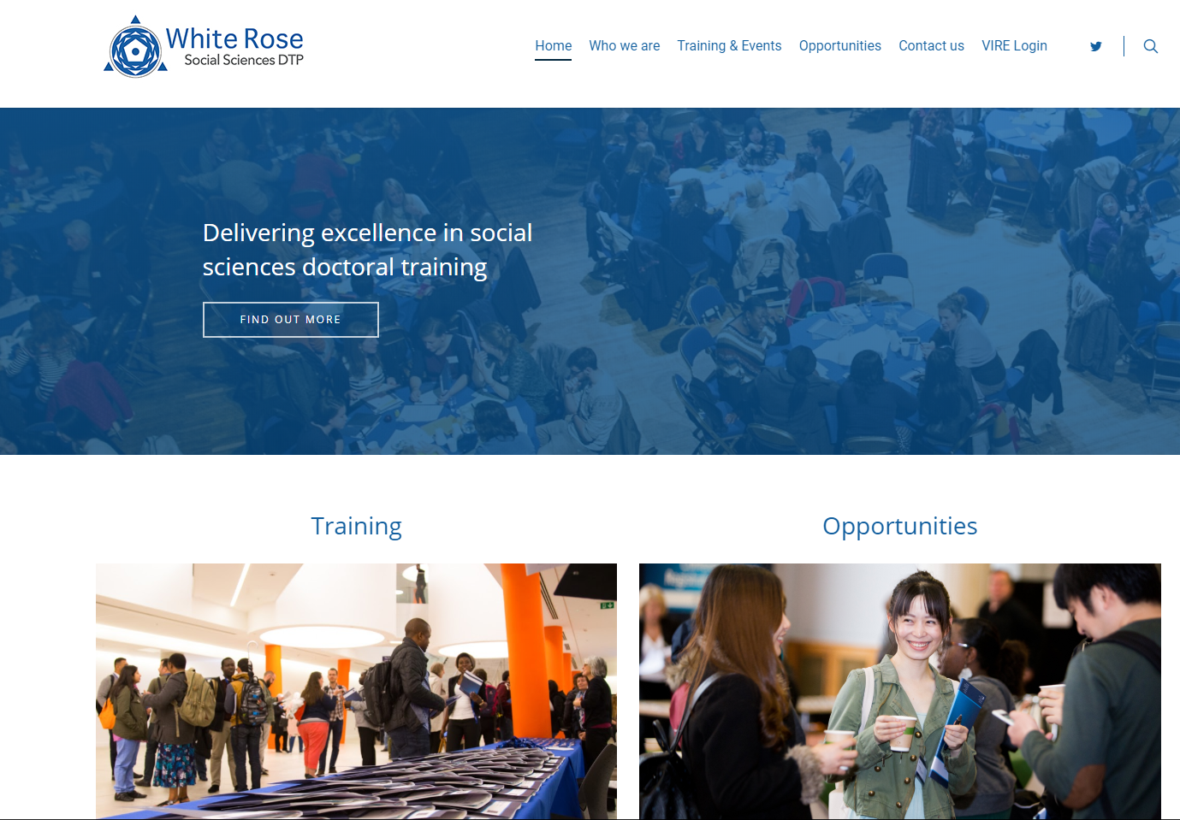
The WRDTP website has been relaunched with a new VIRE area.
This is a secured area which will provide students with access to unique resources created exclusively for the WRDTP as well as recordings of sessions and workshops.
To access the VIRE, click on the ‘VIRE Login’ icon indicated above.

Slide 4
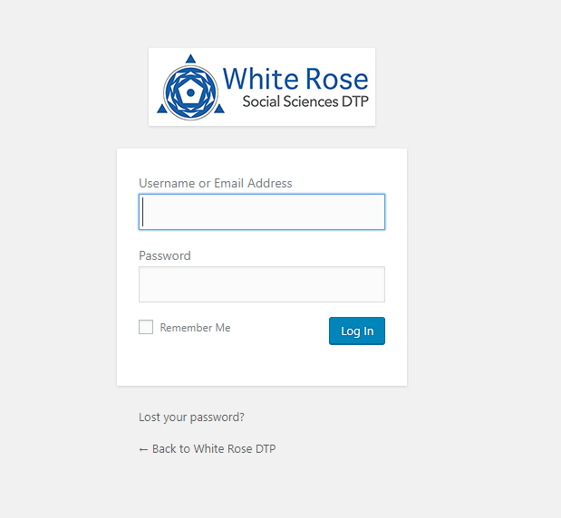
On the following page, users will be asked for a username and password to access the content in the VIRE.
These details can be obtained from the WRDTP Administrator in your home university.
You will not receive an individual username and password, but will have access via an institution login.

Slide 5
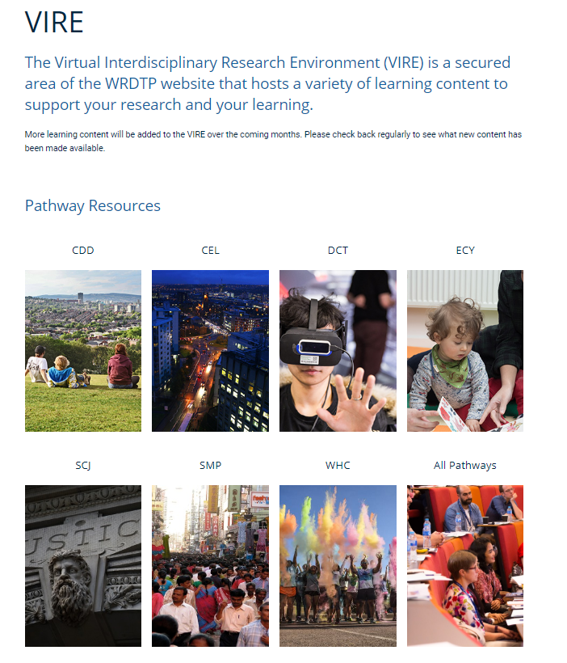
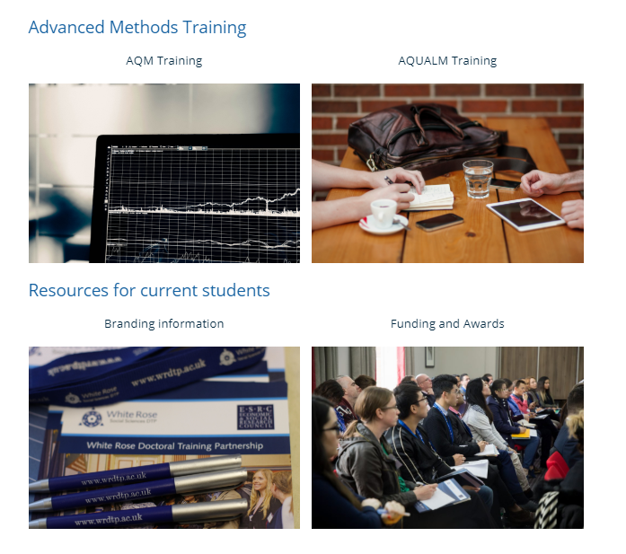
Once in the VIRE you can find dedicated sections for each interdisciplinary pathway, as well as an area for resources and training suitable for all.
There are also sections for both Quantitative and Qualitative research methods, information about using the WRDTP branding and information and application details for funding and awards.

Slide 6
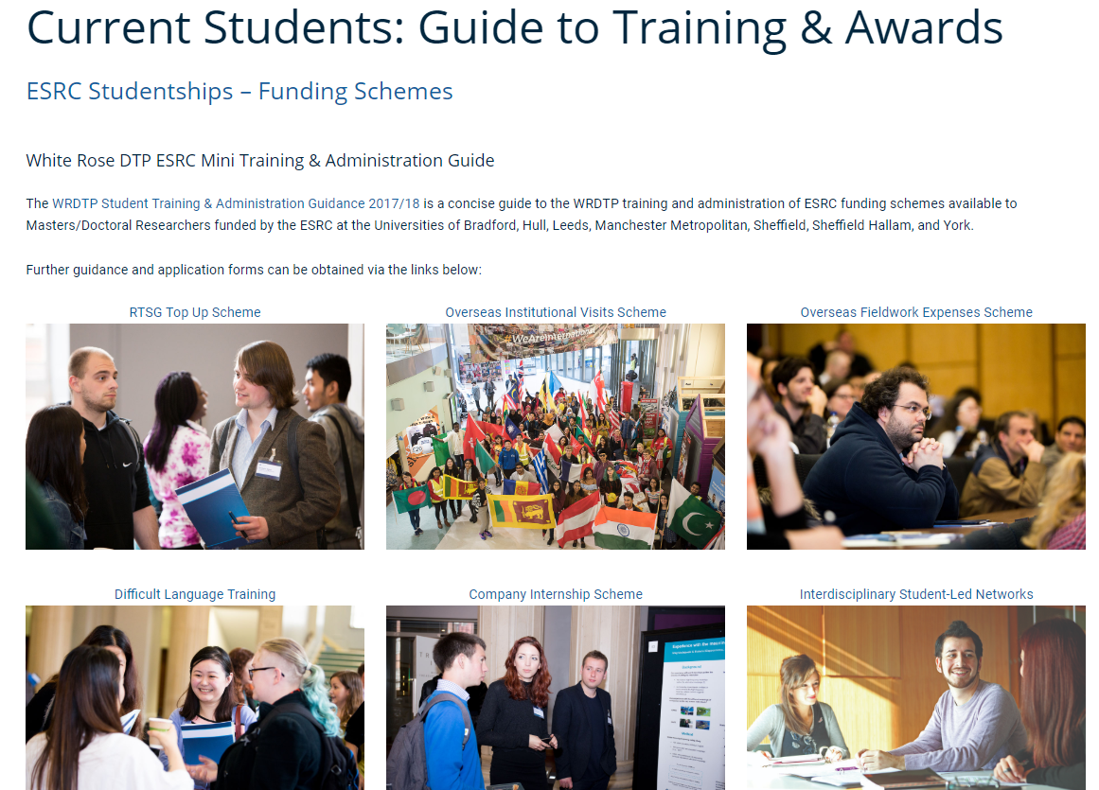
When you’re within a page, click on the image to view the content for that section.
The VIRE will have content added over the course of the year, so make sure to check back regularly to see what is new.

