Slide 1

Sustainability Research Institute
Postgraduate Researcher Induction
Dr Milena Buchs
Associate Professor in Sustainability, Economics, and Low Carbon Transitions
Deputy Director of Postgraduate Research (SRI)
October 2018

Slide 2


Program for this afternoon
Welcome and introductions
SRI Director’s welcome
PhD representatives
Research philosophy module
Research ethics: Dr Alice Temple
SRI Research groups
Wrapping up

Slide 3

Welcome to SRI
Tell us
Your name
History (places & activities)
Topic of PhD in Leeds
Principal supervisor
Why you are pursuing a PhD?
Something personal: Your favourite food

Slide 4
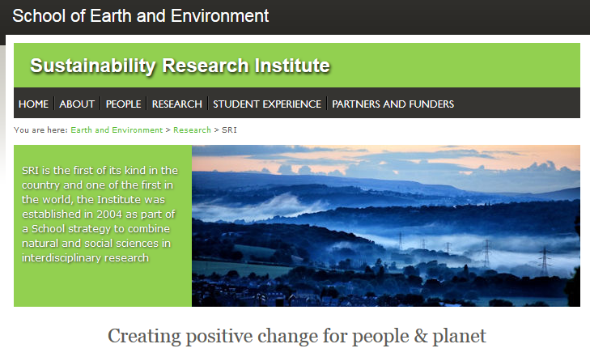
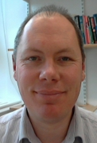
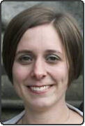
Welcome to SRI!
SRI Directors:
Prof Will Young
Dr Lucie Middlemiss

Slide 5
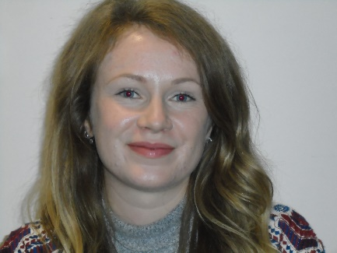
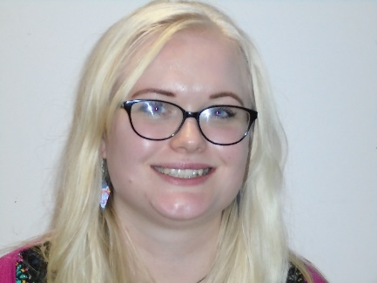
Welcome to SRI
SRI PhD reps
Ruth Smith Catherine Graves
Role of PhD reps
SRI ‘Buddy’ Scheme?
Social events

Slide 6
PhD Reps & Contacts
Contacts
Staff
Director of PGR Studies: Dr Ian Burke
Deputy Directors: Dr Milena Buchs (SRI), Dr Fiona Gill (wellbeing), Dr Lauren Gregoire (modelling)
PGR Administrator: Mrs Michelle Lesnianski
PGR Admissions: Mrs Angela Gardner
PGR Representatives
ICAS: Josh Hampton, Thomas Thorp
ESSI: Andy Mair
IGT: James Ward and Edna Dualeh
SRI: Ruth Smith and Catherine Graves
IAG: Daniel Tek and Emma Pearce
Notes:
Social activities, buddy system, CHANGE

Slide 7
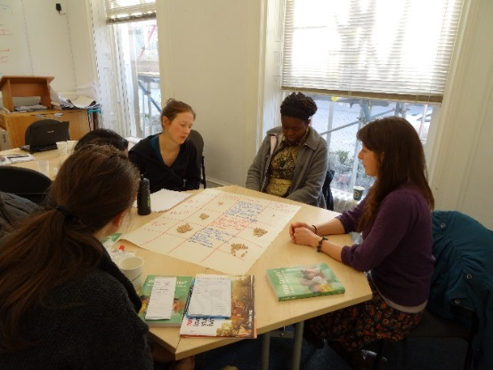
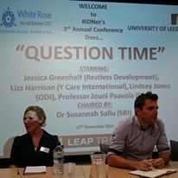

Researchers in Development Network (RiDNet)
A university-wide, student-led network of PhD and early career researchers working in international development and/or doing social research in developing countries.
RiDNet is a unique resource enabling knowledge and ideas sharing, and providing support, advice and training on practical aspects of conducting research in developing contexts.
The network will be hosting a number of events throughout the year including informal lunchtime discussions, workshops, socials and our annual conference.
All new members welcome!
For more info or to be added to the mailing list contact:
ridnet@leeds.ac.uk
Or find out more at:
cgd.leeds.ac.uk/ridnet
facebook.com/RiDNet
Twitter @RiDNet_Leeds

Slide 8
Ethical requirements in PhD research
Dr Alice Temple

Slide 9
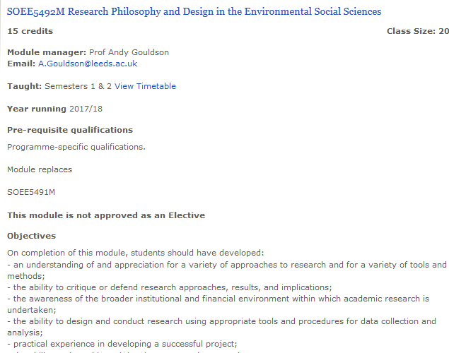
Module on Research Philosophy
http://webprod3.leeds.ac.uk/banner/dynmodules.asp?Y=201718&M=SOEE-5492M
Notes:
change

Slide 10
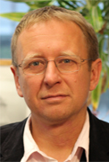
Module SOEE5492M
Research Philosophy and Design in the Environmental Social Sciences
Co-ordinator: Prof Andy Gouldson ( a.gouldson@leeds.ac.uk )
Office School of Earth & Environment, 8.103
Purpose:
To introduce new PhD researchers to PhD research
To help you think through some of your research plans
Format: lectures with discussion
Not assessed

Slide 11
Module SOEE5492M logistics
Research Philosophy and Design in the Environmental Social Sciences
· Location: EC Stoner SR 8.203
· Time: Thursdays, 12 noon for about 1.5 hours (you may need to bring food/drink)
http://webprod3.leeds.ac.uk/banner/dynmodules.asp?Y=201718&M=SOEE-5492M
Notes:
Andy should know 45 mins next Thurs due to SEE session “starting your research degree”

Slide 12
Module SOEE5492M Research Philosophy and Design in the Environmental Social Sciences
Topics (may) include:
Writing a research proposal
Undertaking a literature review
Considering the relative benefits of qualitative and quantitative methods
Training opportunities and making the most of them (Julia Steinberger)
Approaches to knowledge
Science and society
Case studies (Anne Tallontire)
Preparing for fieldwork (Lindsay Stringer)
PhD publication strategy (Julia Steinberger)
Process and benefits of PhD by alternative format (Paul Brockway)
… Preparing Ethics Approval?
And whatever you need: after scheduled sessions, you take over the module.

Slide 13
Methods modules
GEOG5120M | Qualitative research methods
Tues 11-1pm. Manton MR New Zealand
Quantitative analysis methods modules:
GEOG5240M | Applied Population and Demographic Analysis
GEOG5520M | Quantitative and spatial methods
TRAN5060M | Welfare Economics and Cost-Benefit Analysis
TRAN5113M | Transport Econometrics

Slide 14
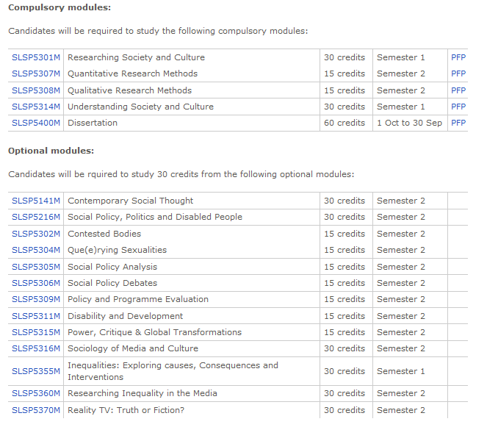
MA Social Research
http://webprod3.leeds.ac.uk/catalogue/dynprogrammes.asp?Y=201718&P=MA-SOC%2FRES

Slide 15
And lots of others?
SOEE5010M | Research Methods
SOEE5041M | Standards and Tools for Business, Environment and Corporate Social Responsibility
SOEE5051M | Business, Environment and Sustainability
SOEE5094M | Introduction to Ecological Economics
SOEE5095M | Environmental Economics and Policy
SOEE5281M | Introduction to Sustainability
SOEE5472M | Environmental Policy and Governance
SOEE5483M | Critical Perspectives in Environment and Development
SOEE5540M | Climate Change: Physical Science Basis
SOEE5550M | Climate Change: Impacts and Adaptation
SOEE5561M | Climate Change Mitigation
SOEE5582M | Tools and Techniques in Ecological Economics
GEOG5240M | Applied Population and Demographic Analysis
PIED5256M | Global Inequalities and Development
PIED5562M | International Relations and the Environment
TRAN5060M | Welfare Economics and Cost-Benefit Analysis
TRAN5113M | Transport Econometrics
TRAN5171M | Analysing Transport and Society

Slide 16
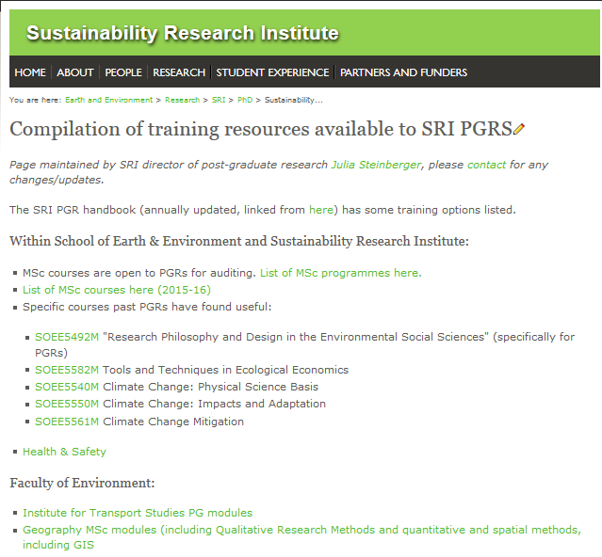
Other training opportunities
http://see.leeds.ac.uk/research/sri/phd/sustainability-research-institute-pgr-training-resources/
Notes:
Changing to training website.

Slide 17
SRI research groups & contacts
Business & Organisations for Sustainable Societies (BOSS) (Coordinator: Dr Sally Russell: S.Russell@leeds.ac.uk )
Economics and Policy for Sustainability (Coordinator: Dr Julia Steinberger j.k.steinberger@leeds.ac.uk)
Energy & Climate Change Mitigation (Coordinators: Dr Catherine (Frin) Bale: C.S.E.Bale@leeds.ac.uk , Dr Katy Roelich: K.E.Roelich@leeds.ac.uk )
Environment and Development Research Group (Coordinator group: Dr Martin Dallimer M.Dallimer@leeds.ac.uk)
Social and Political Dimensions of Sustainability (Coordinator: Dr James Van Alstine J.VanAlstine@leeds.ac.uk)
Notes:
CHECK, change

Slide 18
Research Group activities
Economics and Policy Research Group
Next meeting: Weds October 4th, 10:30-12:00 in 10.125
Energy & Climate Change Mitigation
Next meeting: Weds October 11th, 14:30 – 16:00: 8.03 in staff centre

Slide 19
Research Group activities: reading groups
Well-being Reading Group: contact Lina Brand-Correa: eelibc@leeds.ac.uk, 13:00-14:00, room 10.125, Monday 9th of October
Book 1 of Aristotle’s Ethics, which you can find here: http://classics.mit.edu/Aristotle/nicomachaen.html
Stearns, P. N. (2012). The History of Happiness. Harvard Business Review, (January-February), 104–109.
Environmental Governance Reading Group: Contact Imogen Rattle ee11ikr@leeds.ac.uk
Econopol Reading Group: contact Nathan Wood: eenwo@leeds.ac.uk, Thursday 5th at 12:30 in staff centre room 8.03.
Slavoj Žižek How capital captured politics - https://www.theguardian.com/commentisfree/2014/jul/13/capital-politics-wikileaks-democracy-market-freedom
Fat-free chocolate and absolutely no smoking: why our guilt about consumption is all-consuming - https://www.theguardian.com/artanddesign/2014/may/21/prix-pictet-photography-prize-consumption-slavoj-zizek

Slide 20

2018 WRDTP Welcome Event
https://wrdtp.ac.uk/wrdtp-welcome-event-2018-sheffield/

Slide 21
Any other business
Seminar series & events: SRI, CCCEP, Water@Leeds, Africa College, RIDNet.
Funding for conferences, field work, other academic travel
Studentships, opportunities for work in School (demonstrating assistance)
SRI social life, email lists (see-all, see-sri, sri-research-pg, envnet)
SEE, SRI Facilities, computers, libraries, technical tools, software, etc.

