Slide 1
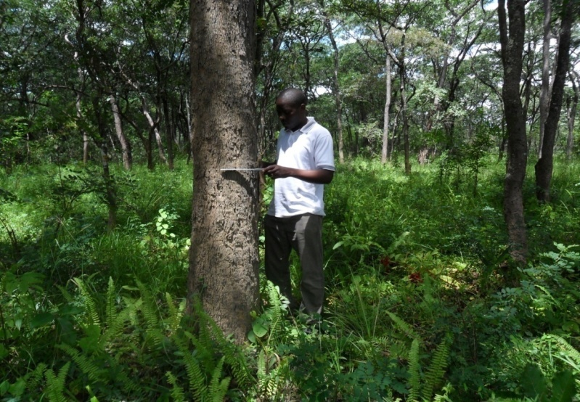
Research on Climate Compatible Development at the School of Earth and Environment, University of Leeds, UK
Recent Research & Publications
Climate Compatible Development (CCD) aims to help people improve their lives in the face of climate threats without exacerbating these threats for current and future generations. Related concepts (e.g. Climate Smart Agriculture, Climate-resilient Pathways) also seek ‘triple wins’ across development, mitigation and adaptation: an increasingly popular approach in research and practice.
Drawing on interdisciplinary approaches, SEE research critically examines Climate Compatible Development: identifying progress, opportunities, challenges and trade-offs across socio-ecological systems.
National, global and regional partnerships with a range of stakeholders (including universities, private sector companies, government ministries, UN secretariats and agencies, NGOs and civil society groups) have enabled research to have a direct impact on decision-making and practice.
Monitoring of miombo woodland plots, Copperbelt District, Zambia
Dixon JL; Stringer LC (2015) Towards a Theoretical Grounding of Climate Resilience Assessments for Smallholder Farming Systems in Sub-Saharan Africa, Resources
Howard RJ; Tallontire AM; Stringer L; Merchant R (2015) Unraveling the Notion of “Fair Carbon”: Key Challenges for Standards Development, World Development
Leventon J; Dyer JC; Van Alstine JD (2015) The private sector in climate governance: Opportunities for climate compatible development through multilevel industry-government engagement, Journal of Cleaner Production
Locatelli B, Pavageau C. Pramova E, Di Gregorio M, (2015). Integrating climate change mitigation and adaptation in agriculture and forestry: Opportunities and trade-offs. Wiley Interdisciplinary Reviews: Climate Change
Shackleton S; Ziervogel G; Sallu SM; Gill T; Tschakert P (2015) Why is socially-just climate change adaptation in sub-Saharan Africa so challenging? A review of barriers identified from empirical cases, Wiley Interdisciplinary Reviews: Climate Change
Whitfield S; Dougill A; Dyer J; Kalaba F; Leventon J; Stringer LC (2015) Critical reflection on knowledge and narratives of conservation agriculture, Geoforum
Recent Publications
Atela JO; Minang PA; Quinn CH; Duguma LA (2015) Implementing REDD+ at the local level: Assessing the key enablers for credible mitigation and sustainable livelihood outcomes, Journal of Environmental Management
Berman RJ; Quinn CH; Paavola J (2015) Identifying drivers of household coping strategies to multiple climatic hazards in Western Uganda: implications for adapting to future climate change, Climate and Development
Brügger A; Brügger A; Morton TA; Dessai S (2015) Hand in hand: Public endorsement of climate change mitigation and adaptation, PLoS ONE
Challinor AJ; Parkes B; Ramirez-Villegas J (2015) Crop yield response to climate change varies with cropping intensity, Global Change Biology
The School of Earth and Environment is established as one of the leading centres of international excellence across the Earth and Environmental Sciences.
The School mission is “to lead internationally in research, to deliver a high quality of learning and teaching in Earth and Environmental Sciences and hence to beneficially impact society”.
SEE offers MSc and PhD in environment, development, and climate change seeking novel interdisciplinary problem-based solutions to a range of adaptation, mitigation and development issues . For more information see www.leeds.ac.uk/see

Slide 2
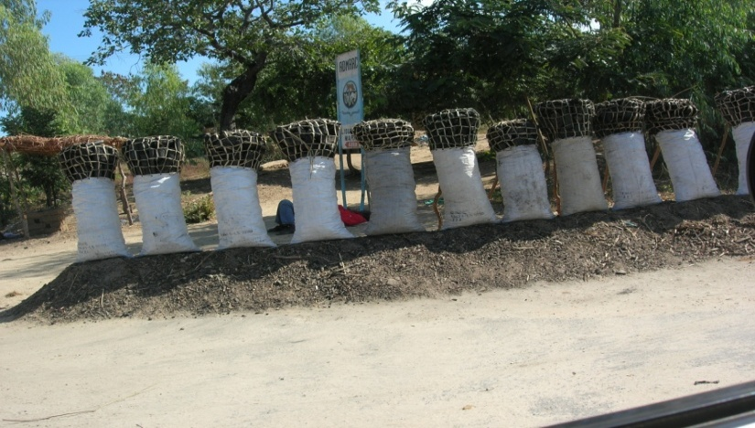
Research on Climate Compatible Development at the School of Earth and Environment, University of Leeds, UK
Wood BT; Sallu SM; Paavola J (2015) Can CDM finance energy access in Least Developed Countries? Evidence from Tanzania, Climate Policy
Challinor AJ; Watson J; Lobell DB; Howden SM; Smith DR; Chhetri N (2014) A meta-analysis of crop yield under climate change and adaptation, Nature Climate Change
Islam MM; Sallu SM; Hubacek K; Paavola J (2014) Vulnerability of fishery-based livelihoods to the impacts of climate variability and change: insights from coastal Bangladesh, Regional Environmental Change
Islam MM; Sallu S; Hubacek K; Paavola J (2014) Limits and barriers to adaptation to climate variability and change in Bangladeshi coastal fishing communities, Marine Policy
Lamb WF; Steinberger JK; Bows-Larkin A; Peters GP; Roberts JT; Wood FR (2014) Transitions in pathways of human development and carbon emissions, Environmental Research Letters
Mathur V; Afionis S; Paavola J; Dougill AJ; Stringer LC (2014) Experiences of host communities with carbon market projects: towards multi-level climate justice, Climate Policy
Stringer LC; Dougill AJ; Dyer JC; Vincent K; Fritzsche F; Leventon J; Falcão MP; Manyakaidze P; Syampungani S; Powell P; Kalaba G (2014) Advancing climate compatible development: lessons from southern Africa, Regional Environmental Change
Suckall N; Tompkins E; Stringer L (2014) Identifying trade-offs between adaptation, mitigation and development in community responses to climate and socio-economic stresses: Evidence from Zanzibar, Tanzania, Applied Geography
Suckall N; Stringer LC; Tompkins EL (2014) Presenting triple-wins? assessing projects that deliver adaptation, mitigation and development co-benefits in rural Sub-Saharan Africa, AMBIO
Our research focuses on themes including institutions and governance; carbon sinks; integrated carbon management; carbon finance; community-based natural resource management; forests and REDD+; social justice; risk and communication; vulnerability and poverty reduction. Geographically we focus on both developed and developing regions.
Current projects
The Climate Compatible Development in East and Southern Africa project examines the nature and functioning of multi-stakeholder approaches that enable climate change mitigation and enhanced rural adaptive capacity; and shares practical experiences emerging from research.
The Climate-resilient Pathways and Adaptation research project examines agriculture and food security adaptation strategies required for future climates.
The Governing Rapid Transitions in Mitigation and Adaptation project uses economic and institutional approaches to examine what a systemic transition to a low-carbon, climate-resilient economy might look like.
The Multi-level Governance, REDD+ and Synergies between Climate Change Mitigation and Adaptation project seeks to understand the extent to which policy processes related to forest mitigation and adaptation should be integrated at different scales.
The Climate Compatible Development PhD training Network works with partner Universities across Yorkshire (Sheffield & York) and partner institutions globally on issues of climate change and development.
Bags of charcoal, for sale at the roadside in Malawi
Leeds researchers working on Climate Compatible Development include Monica Di Gregorio, Andy Dougill, Jen Dyer, Elizabeth Harrison, Stavros Afionis, Jouni Paavola, Claire Quinn, Susannah Sallu, Matthew England, Kate Massarella, Andy Challinor Julian Ramirez-Villegas, Ann-Kristan Koehler, Dominick Spracklen, Lindsay Stringer, Stephen Whitfield, Joanes Atela, Rebecca Howard, Anne Tallontire, Vivek Mathur, Suraje Dessai, Julia Steinberger, James Van Alstine and Ben Wood For more information about any of these papers please contact Claire Quinn: C.Quinn@leeds.ac.uk

