Slide 1
Exercise set 5:
Unconformities and Faults
To view this exercise just press F5 now. Then click the mouse to continue through the slides.
School of Earth and Environment

Slide 2
Unconformities and Faults
This presentation is to be completed in conjunction with exercise worksheet 5.
Objectives:
By the end of this exercise you should:
Be able to construct cross sections of unconformities.
Be able to calculate the throw and type of a fault.
This exercise will build on many of the concepts you have learnt so far, utilising:
Folded structures.
Fault terminology
Drawing cross sections.
Calculating true thickness.
School of Earth and Environment

Slide 3
Unconformities and Faults: Problem 1
As we have previously covered the techniques necessary to complete these exercises, we will move straight onto problems instead of going through an example.
Using exercise worksheet 5, complete problem 1 before continuing onto the next slide.
Questions for problem 1:
Indicate on the map the outcrop of the plane of unconformity
Indicate on the map the position of an anticlinal axis with the symbol:
and a synclinal axis with the symbol:
Using structure contours, draw a cross section along line A to B.
In a few sentences outline the geological history of the map area.
School of Earth and Environment

Slide 4
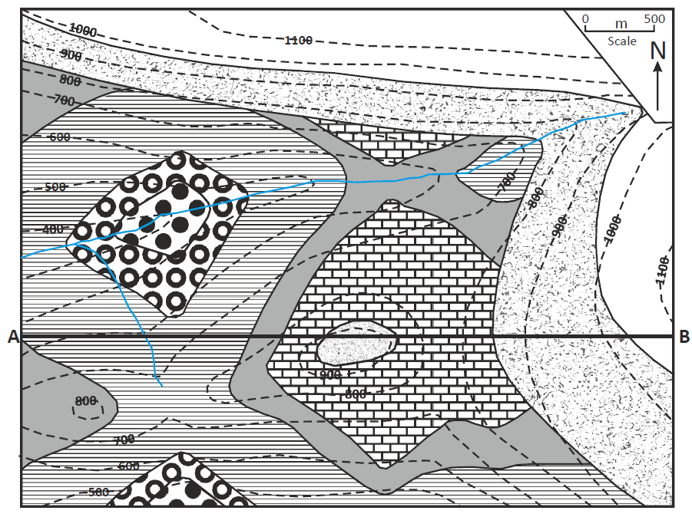
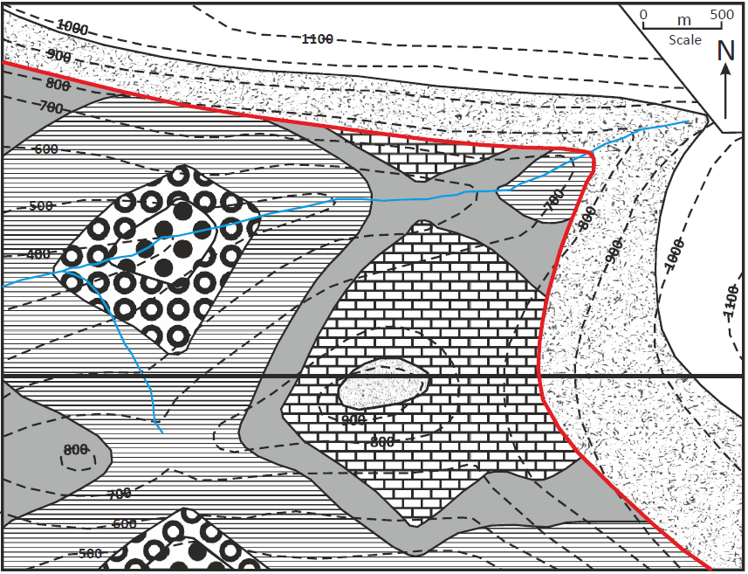
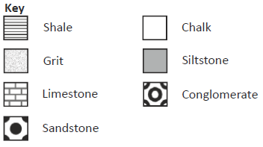
Unconformities and Faults: Problem 1
The plane of unconformity is evident as it lies on top of the older rock. This boundary can also be double checked as often the rock above the unconformity will have a different strike and/or dip to the older rock.
School of Earth and Environment

Slide 5
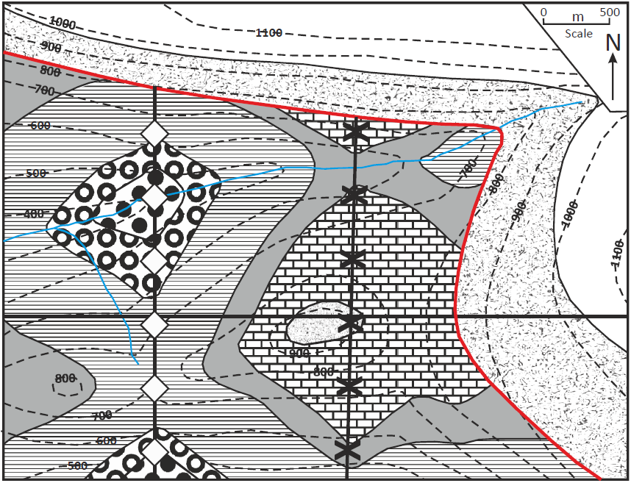
Unconformities and Faults: Problem 1
To add syncline and anticline axes: remember anticlines young outwards and synclines young inwards. Then following the law of superposition the youngest rock must also have been on top prior to any deformation.
School of Earth and Environment

Slide 6
Unconformities and Faults: Problem 1
Firstly, add the topographic points and outcrop interfaces to your cross section.
School of Earth and Environment

Slide 7
Unconformities and Faults: Problem 1
Firstly, add the topographic points and outcrop interfaces to your cross section.
School of Earth and Environment

Slide 8
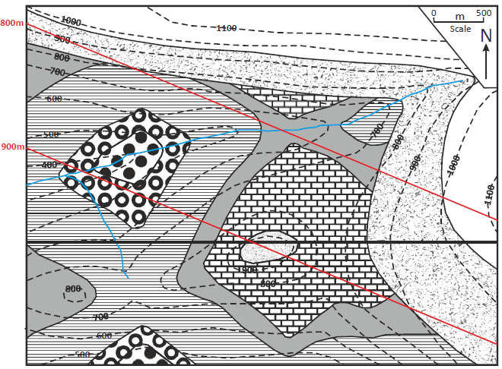
Unconformities and Faults: Problem 1
Now add the structure contours of the plane of unconformity (the base of the grit).
School of Earth and Environment

Slide 9
Unconformities and Faults: Problem 1
And add these points to your cross section.
School of Earth and Environment

Slide 10
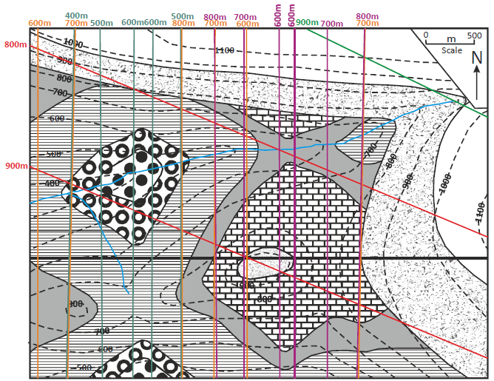
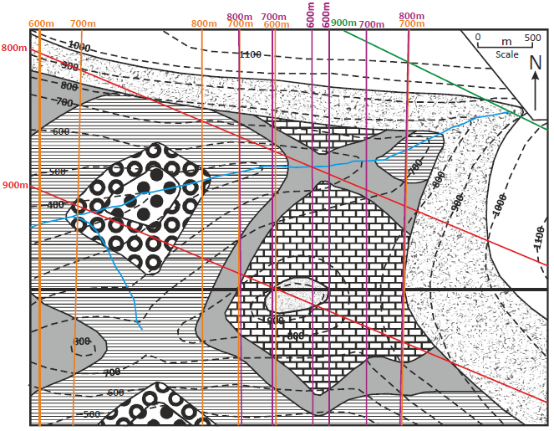
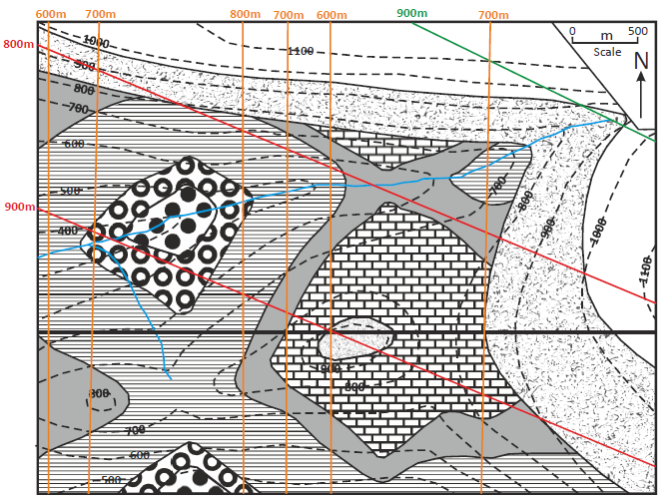
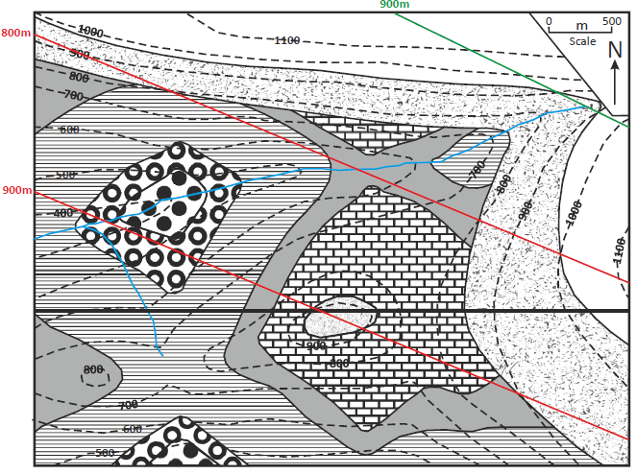
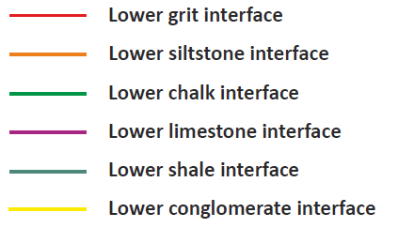
Unconformities and Faults: Problem 1
Continue to add these structure contours to your map and cross section until all possible boundaries have been defined.
School of Earth and Environment

Slide 11
Unconformities and Faults: Problem 1
Continue to add these structure contours to your map and cross section until all possible boundaries have been defined.
School of Earth and Environment

Slide 12
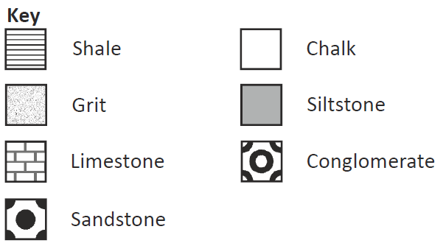
Unconformities and Faults: Problem 1
Now draw in the boundaries of the different lithological units. (Remember to use dotted lines where the boundaries are unknown.
School of Earth and Environment

Slide 13
Unconformities and Faults: Problem 1
Now extend the boundaries of the different lithological units using dotted lines to show where they would of been prior to erosion. This is now your completed geological cross section.
School of Earth and Environment

Slide 14
Unconformities and Faults: Problem 1
Brief geological history of the map area:
Sandstone deposited
Conglomerate deposited
Shale deposited
Siltstone deposited
Limestone deposited
Beds folded into anticline and syncline
Beds eroded
Grit depsoited
Chalk deposited
All beds tilted and eroded
School of Earth and Environment

Slide 15
Unconformities and Faults: Problem 2
Using exercise worksheet 5, complete problem 2 before continuing onto the next slide.
Questions for problem 2:
Draw structure contours for the upper and lower interfaces of the grit.
What is the true thickness of the grit?
What is the throw of the fault?
Draw structure contours on the fault plane, then determine if the fault is a normal or reversed fault?
Bonus question: Is there anywhere on the map, where, if a borehole was drilled it would not intercept the grit bed?
School of Earth and Environment

Slide 16
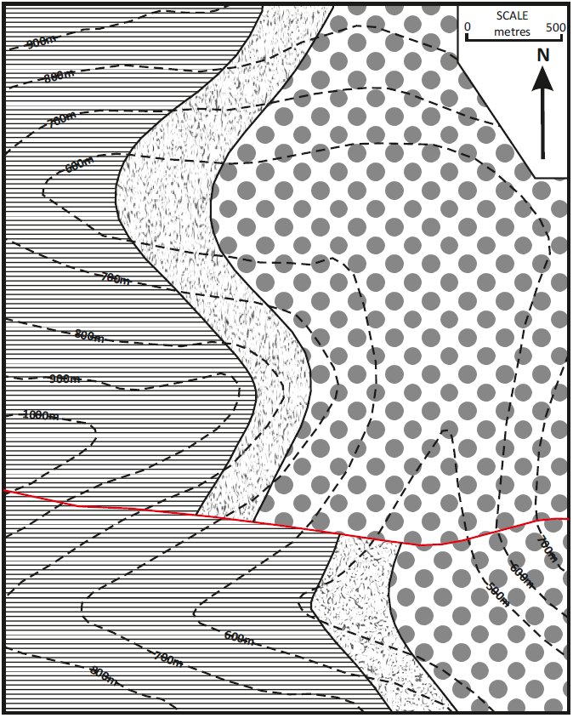
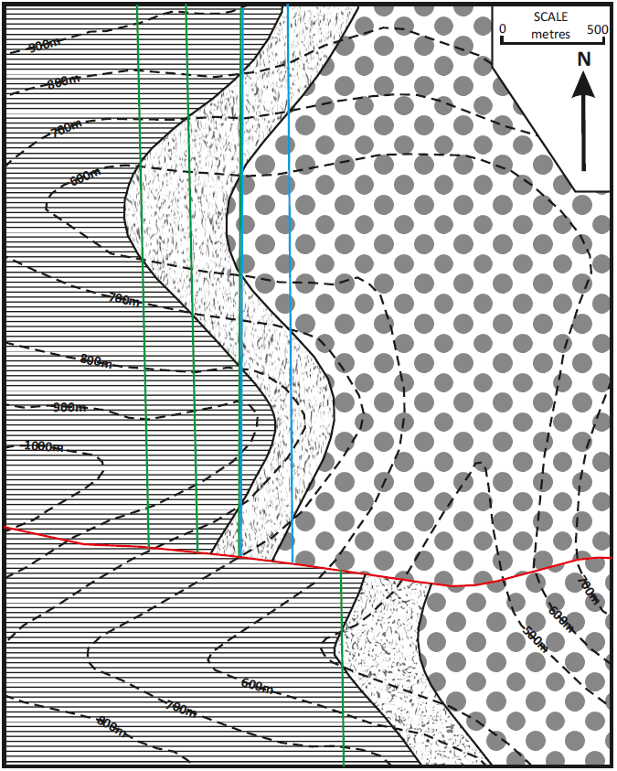
Unconformities and Faults: Problem 2
Structure contours can be drawn for the upper and lower interfaces of the grit unit North of the fault. However, only one structure contour can be drawn South of the fault and this is for the lower grit interface.
School of Earth and Environment

Slide 17
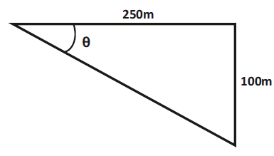
Unconformities and Faults: Problem 2
Answers for problem 2:
Remember to calculate true thickness:
True thickness (t) = width of outcrop (w) x sin(θ) (angle of dip)
So first we must calculate the angle of dip using structure contours (e.g. the most Westerly grit structure contours: 700m and 600m.)
The distance between these is: ~12.5mm = 250m.
The difference in height is: 700m-600m = 100m
Therefore:
tan(θ) = (opp/adj) tan(θ) = (100m/250m) tan⁻¹(100m/250m) = θ = 22°
True dip = 22°
So: True thickness (t) = 522m x sin(22°)
True thickness (t) = 195 m
School of Earth and Environment

Slide 18
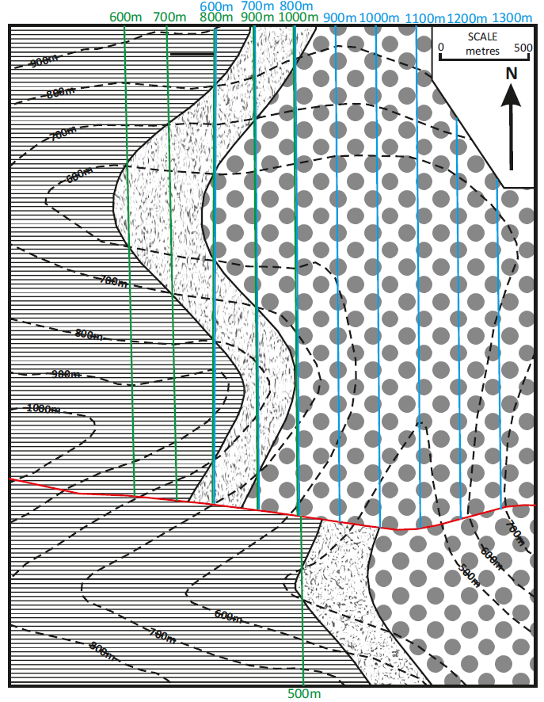
Unconformities and Faults: Problem 2
By assuming a constant dip of the beds we can add more structure contours to the map.
Now to determine the throw of the fault, we should see which lower grit interface structure contour North of the fault, coincides with the 500m lower grit interface structure contour South of the fault.
This is the 1000m structure contour. Therefore, the throw of the fault is:
1000m – 500m = 500m to the South
School of Earth and Environment

Slide 19
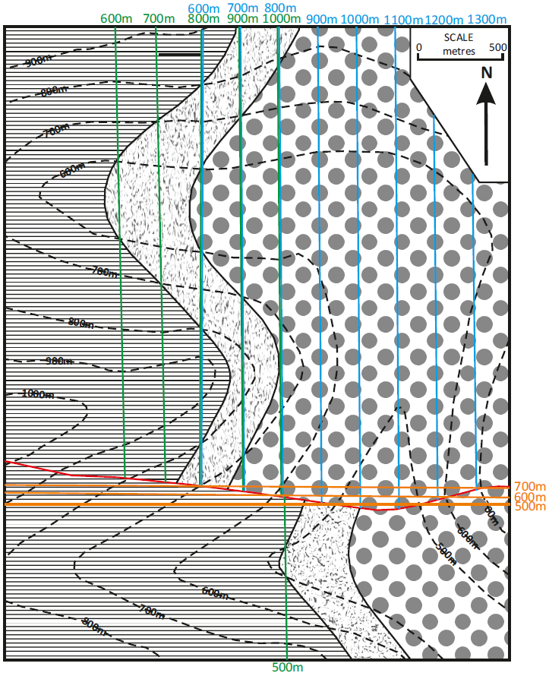
Unconformities and Faults: Problem 2
Structure contours of the fault can be drawn where the fault crosses the same topographical contour, like we can do with the beds.
These show the fault dips to the South. Also, as we have already found out, the South of the fault is the downthrow side. This means the fault is a normal fault.
Remember: If the fault is vertical or dips towards the downthrow side, it is a normal fault. If the fault plane dips in the opposite direction to the downthrow (i.e. Toward the upthrow side) it is a reversed fault.
School of Earth and Environment

Slide 20
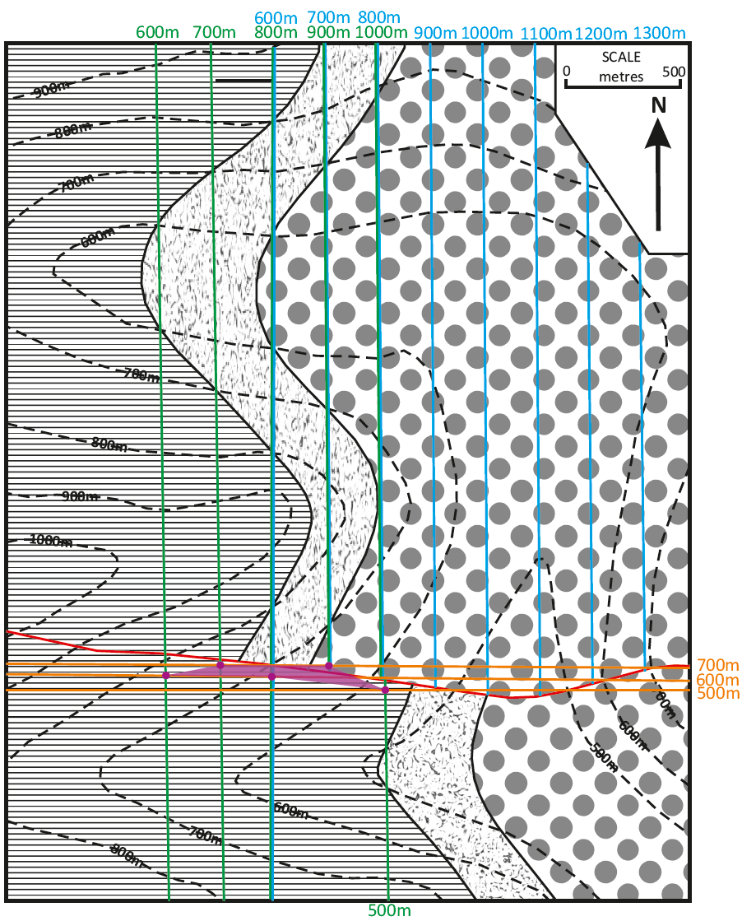
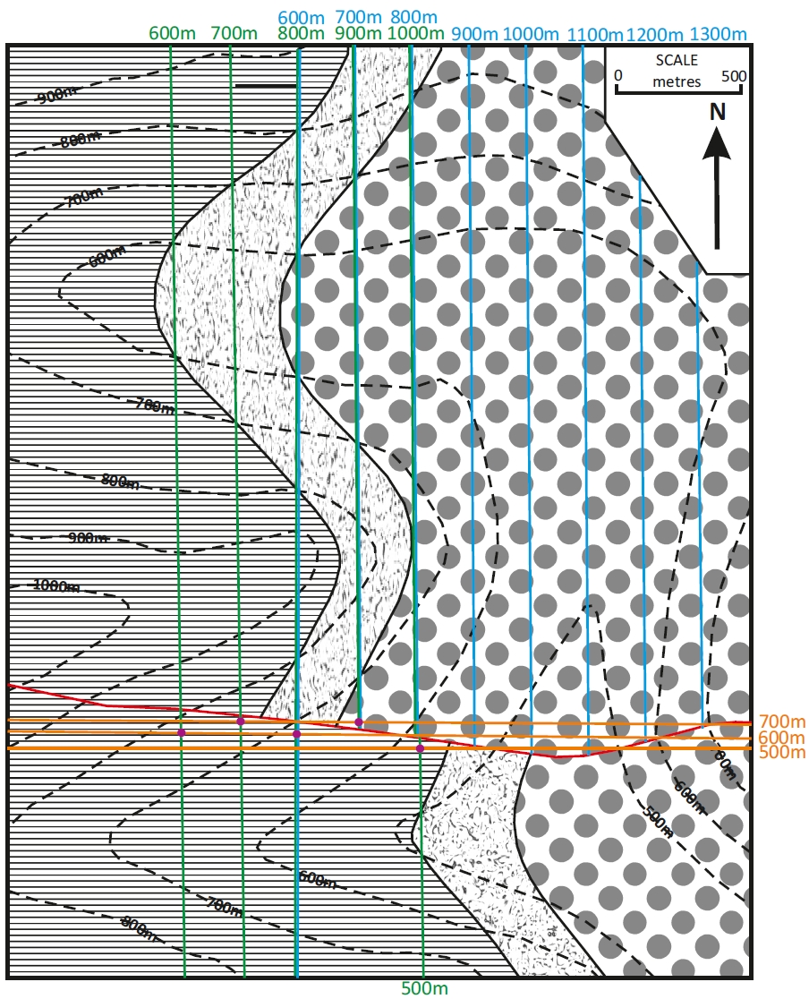
Unconformities and Faults: Problem 2
There are areas where boreholes would not encounter the sandstone at all due to the heave (or want) of the fault.
This zone can be defined by constructing structure contours for the sloping fault plane as well as for the top and bottom of the sandstone. Intersections of these two sets of lines, where they are of the same height, will define the area(s) of absence, or partial absence, of the sandstone.
School of Earth and Environment

Slide 21
Summary
We have now worked through how to:
Construct cross sections of unconformities.
Calculate the throw and type of a fault.
School of Earth and Environment

