Slide 1

Exercise set 1:
V-Outcrop Patterns
To view this exercise just press F5 now. Then click the mouse to continue through the slides.
School of Earth and Environment

Slide 2
This presentation is to be completed in conjunction with exercise sheet 1.
Objectives:
By the end of this section you should be able to draw the outcrop pattern
and topographic pattern of:
    Horizontal beds
    Vertical beds
    Downstream dipping beds
    Upstream dipping beds
School of Earth and Environment

Slide 3
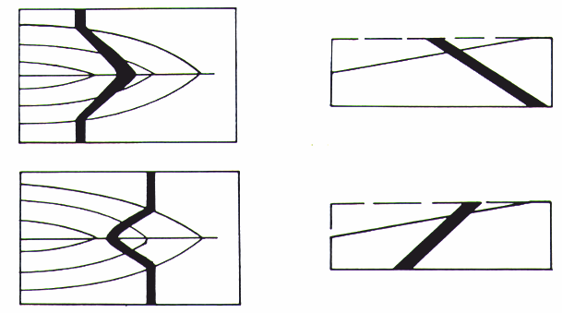
The Law of “V’s”!
  V-outcrop patterns can be used to deduce the dip direction of inclined strata and estimate the amount of dip.
  Beds dipping downstream V-downstream
  Beds dipping upstream V-upstream
School of Earth and Environment

Slide 4
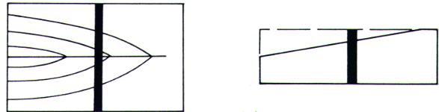
The Law of “V’s”!
Outcrops of horizontal beds will always appear parallel to contour lines.
Outcrops of vertical beds will always parallel the direction of strike, regardless of terrain.
e.g. vertical dike intruded into older strata
Vertical structures are usually easy to spot on satellite imagery, air photos
School of Earth and Environment

Slide 5
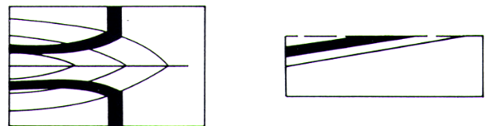
The Law of “V’s”!
Inclined bedding dipping at same gradient as stream will parallel stream valley contours
School of Earth and Environment

Slide 6
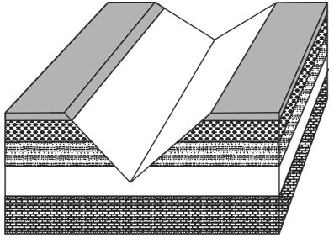
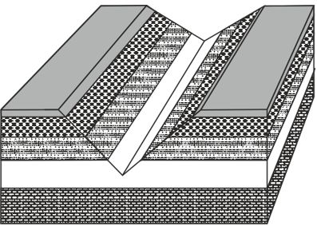
V-outcrop exercise 1A
Now lets have a go at some exercises.
On the exercise one handout, fill in the missing outcrop pattern for exercise 1A.
Once you have attempted this, click again for the answer.
School of Earth and Environment

Slide 7
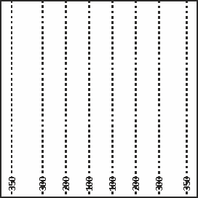
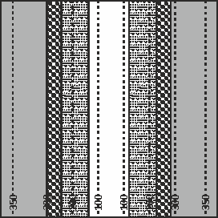
V-outcrop exercise 1A
Now lets have a go at the topographic map with contours for exercise 1A.
Once you have attempted this click again for the answer.
School of Earth and Environment

Slide 8
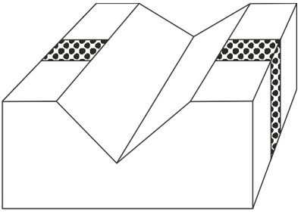
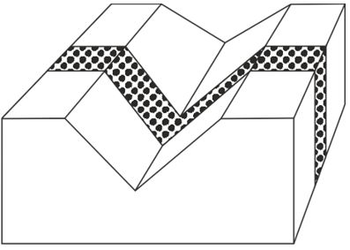
V-outcrop exercise 1B
Now lets have a go at exercise 1B.
Once you have attempted this, click again for the answer.
School of Earth and Environment

Slide 9
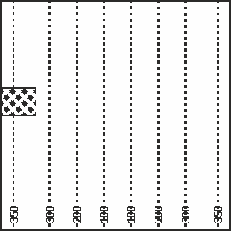
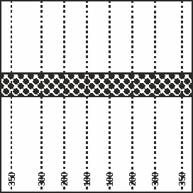
V-outcrop exercise 1B
Now lets have a go at the topographic map with contours for exercise 1B.
Once you have attempted this click again for the answer.
School of Earth and Environment

Slide 10
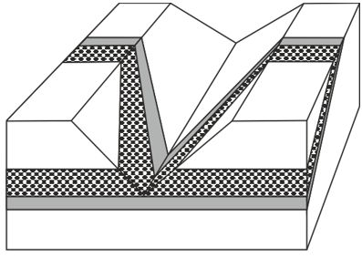
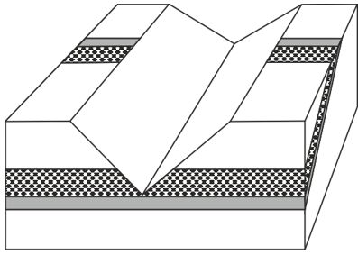
V-outcrop exercise 1C
Now lets have a go at exercise C.
Once you have attempted this, click again for the answer.
School of Earth and Environment

Slide 11
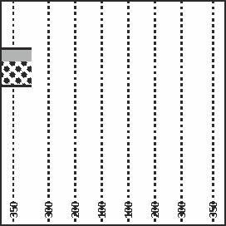
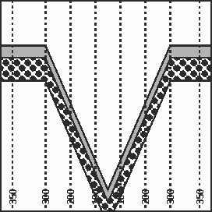
V-outcrop exercise 1C
Now lets have a go at the topographic map with contours for exercise C.
Once you have attempted this click again for the answer.
School of Earth and Environment

Slide 12
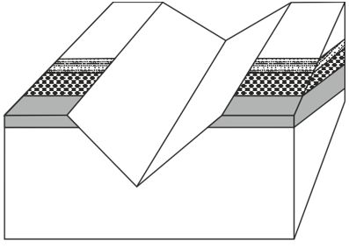
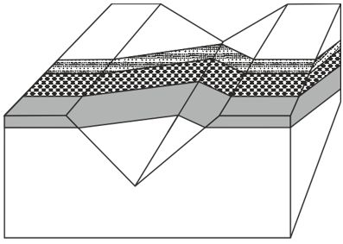
V-outcrop exercise 1D
Now lets have a go at exercise 1D.
Once you have attempted this, click again for the answer.
School of Earth and Environment

Slide 13
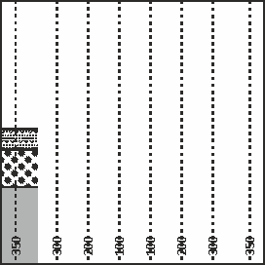
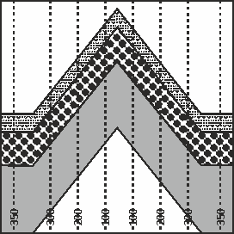
V-outcrop exercise 1D
Now lets have a go at the topographic map with contours for exercise 1D.
Once you have attempted this click again for the answer.
School of Earth and Environment

Slide 14
Summary
You should now be able to draw the outcrop pattern and topographic pattern of:
    Horizontal beds
    Vertical beds
    Downstream dipping beds
    Upstream dipping beds
If you are finding it hard to visualise the concepts covered in this exercise then:
      Review the explanations at the beginning of the exercise.
      Also have a go at building the 3 dimensional model of V-outcrops on the following slide and included at the back of the worksheet.
School of Earth and Environment

Slide 15
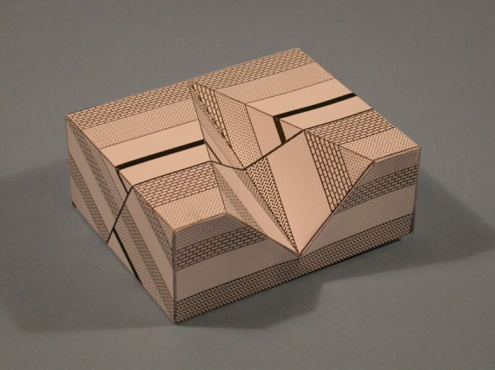
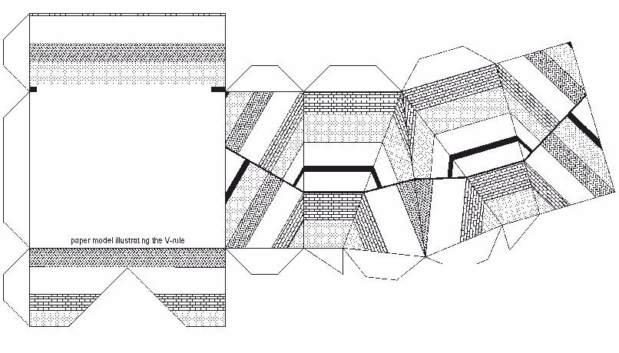


V-Outcrop including fault
School of Earth and Environment

